Slide 1

Final Project Data Analytics
Impact of gas extraction on Dutch real estate value and demand
Maurits Siemonsma
Ironhack Data Analytics Bootcamp FTAUG24

Slide 2



Slide 4


Slide 5


Slide 7


Slide 8
Outline
Research objective
History and key facts
Hypotheses formed
Definitions
Methodology
Findings
Conclusion
Challenges
Limitations

Slide 9

Research objective
To find a relationship between the natural gas extraction in the Province of Groningen and its local real estate value.
Explorative Data Analysis
Research problem
Hypothesis forming
Data gathering
APIs, CSV
Cleaning / combining
Analysis
Visualisation
Jupyter / SQL
Jupyter, Tableau
Tableau / Powerpoint

Slide 10
History and key facts
1,120 induced earthquakes >1.0 magnitude since 1997
267,466 damage claims made due to earthquakes
85,000 addresses affected
Notes:
Historical background
Why are they extracting? How much?
Damages, figures
What do locals think about this?
Controversies

Slide 11
Context and key facts (cont.)

Slide 12
History and key facts (cont.)
1959: gas discovery in Groningen, Netherlands
1963: start gas extraction
1963 - 19 April 2024: 2,246 billion cubic meters gas extracted
363 billion Euros benefitted to Dutch government

Slide 13
Context and key facts (cont.)
https://public.tableau.com/app/profile/maurits.siemonsma/viz/fp_choroplethsstacked/StoryFPIH?publish=yes

Slide 14
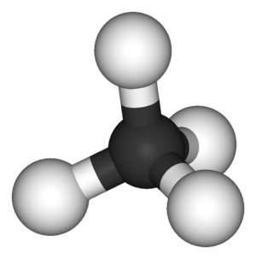
Hypotheses formed
Hypothesis_1: Gas extraction has negatively impacted local real estate value
Hypothesis_2: Areas impacted by gas extraction are less occupied than areas that are not impacted

Slide 15
Definitions
Real estate value =
Occupation rate =
Target city =
Benchmark city =
Target region =
Benchmark region =
Market value of immovable property
Isolated sample that is affected by researched variable
Control isolated sample that is not affected by the researched variable
Averaged sample that is affected by the researched variable
Control averaged sample that is not affected by the researched variable
property occupied
property available

Slide 16
Tableau

Slide 17
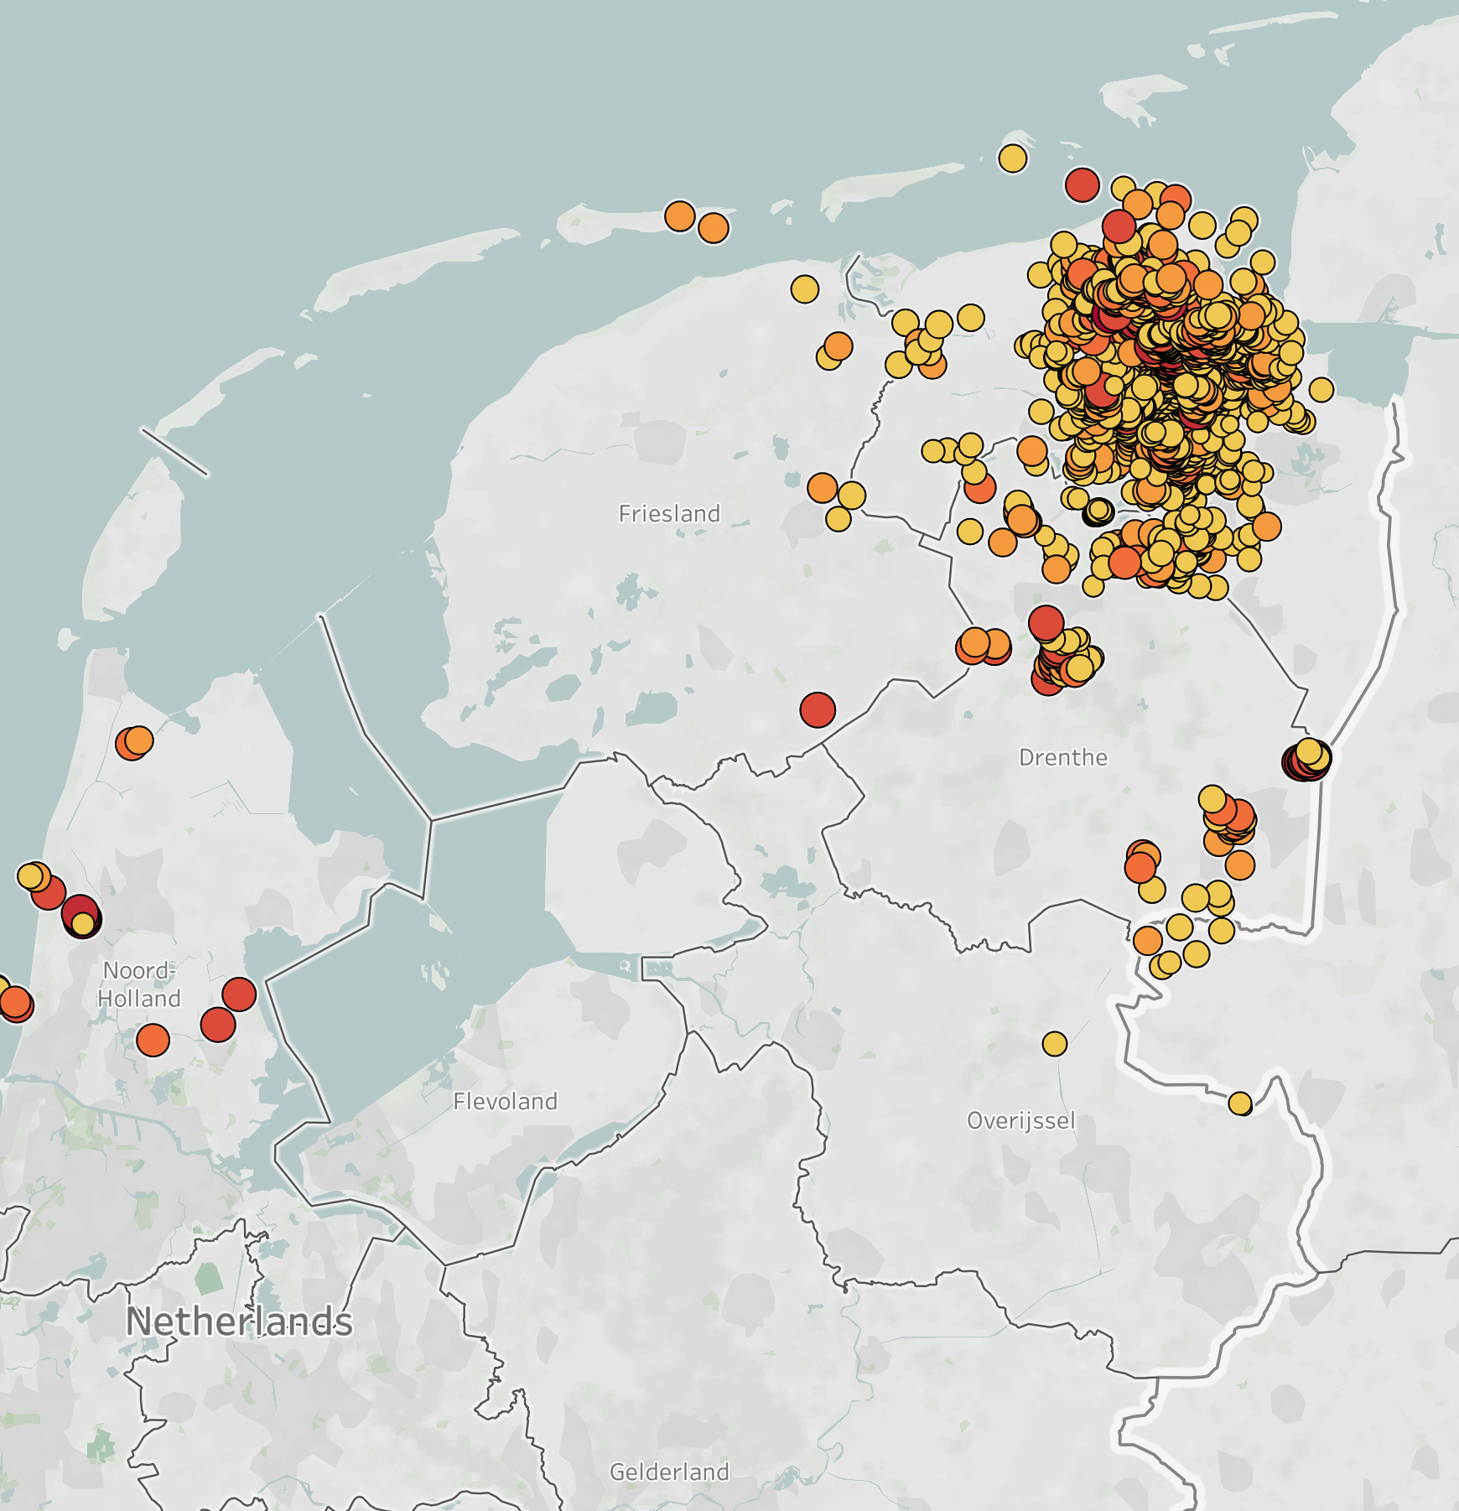

Comparison of target city and benchmark
City level analysis:
Select heavy hitted city in epicentre: Appingedam
Select comparable benchmark city in non affected area: BM = Franeker
Regional level analysis:
Compare metrics between the affected region Groningen against a comparable non-affected region
BM = Friesland.

Slide 18


Comparison of target city and benchmark
TARGET CITY:
Appingedam
Province:
Groningen, NL
Population:
11,085
Total inhabited buildings:
6,184
Earthquake occurances:
89
Data as of 1 January 2024
BENCHMARK CITY:
Franeker
Province:
Friesland, NL
Population:
13,015 (+17.41%)
Total inhabited buildings:
6,328 (+2.33%)
Earthquake occurances:
0 (-100%)
Data as of 1 January 2024

Slide 19
Data and methods used
For both the target city and benchmark city, as well as the target region and benchmark region:
1️⃣ Collect historical mean real estate values;
2️⃣ Collect historical real estate inventory and occupation figures;
3️⃣ Compare datasets and analyse with visualisation tools and statistical t-testing.

Slide 20
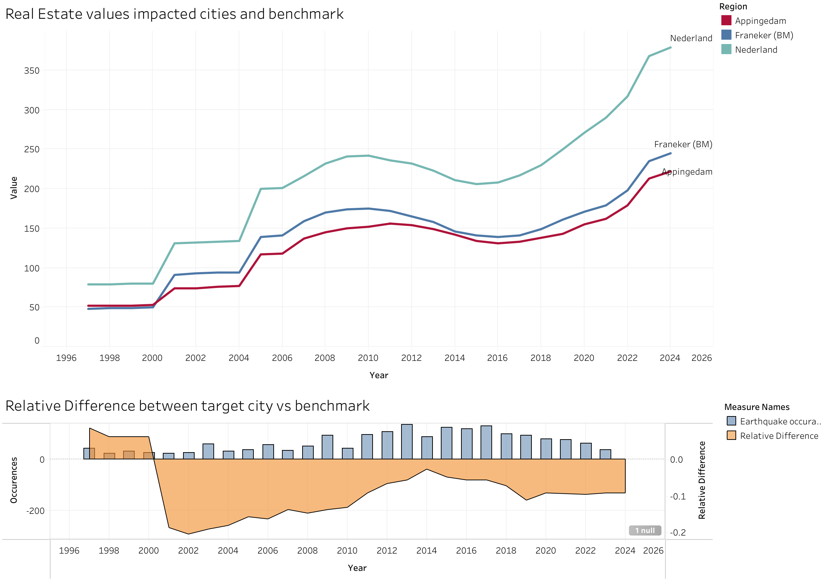
Findings: Real Estate value for target city and benchmark
CITIES
One-tailed paired t-test
Null hypothesis: real estate value of target city and benchmark are equal =
Alternative hypothesis: real estate value of target city is lower than benchmark <
Alpha = 0.0500
t-statistic: -8.0326
p-value: 0.0000
P-value < alpha: rejected null hypothesis:
-> Answer: There is significant evidence that prices in target city are lower than in the BM city.
Target had lower prices in 24 out of 28 years

Slide 21
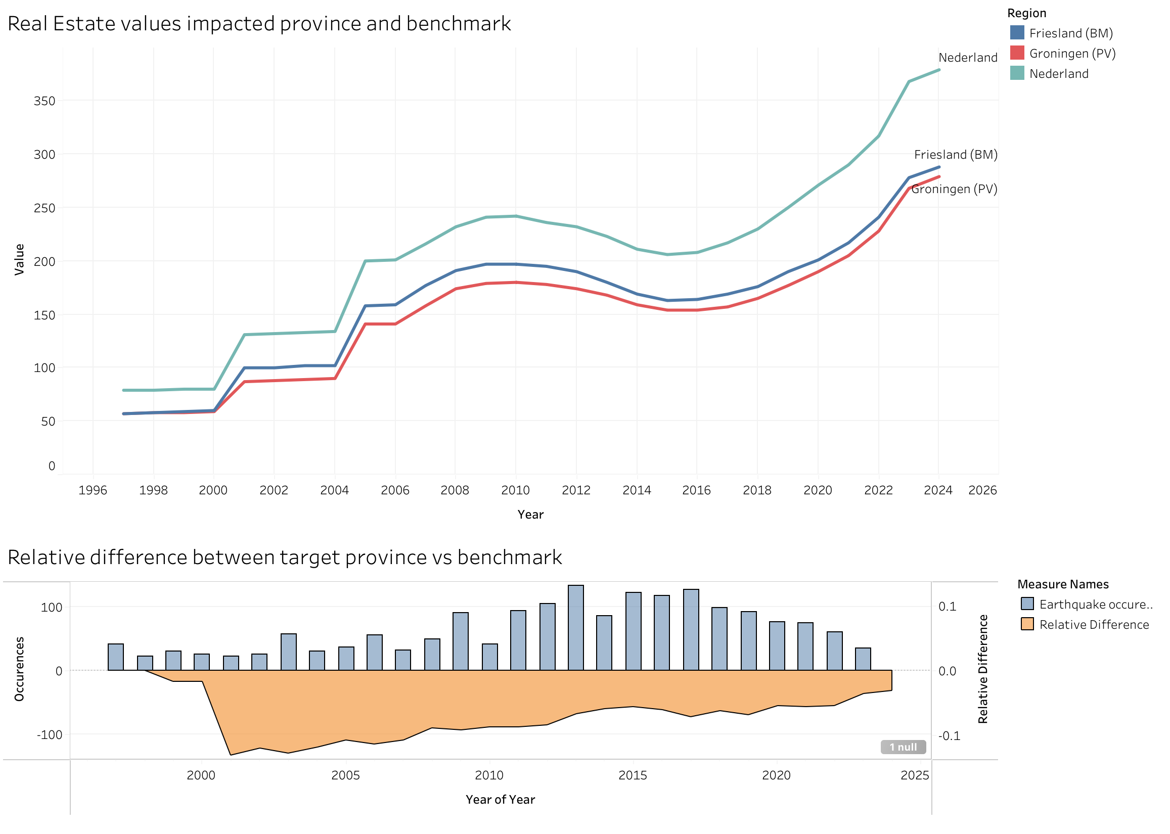
Findings: Real Estate value for affected region and benchmark
REGION
One-tailed paired t-test:
Null hypothesis: real estate value of target region and benchmark are equal =
Alternative hypothesis: real estate value of target region is lower than benchmark <
Alpha = 0.0500
t-statistic: -11.2353
p-value: 0.0000
P-value < alpha, rejected null hypothesis:
-> Answer: There is significant evidence that prices in target region are lower than in the BM region.
Target region had lower prices 26 out of 28 years

Slide 22
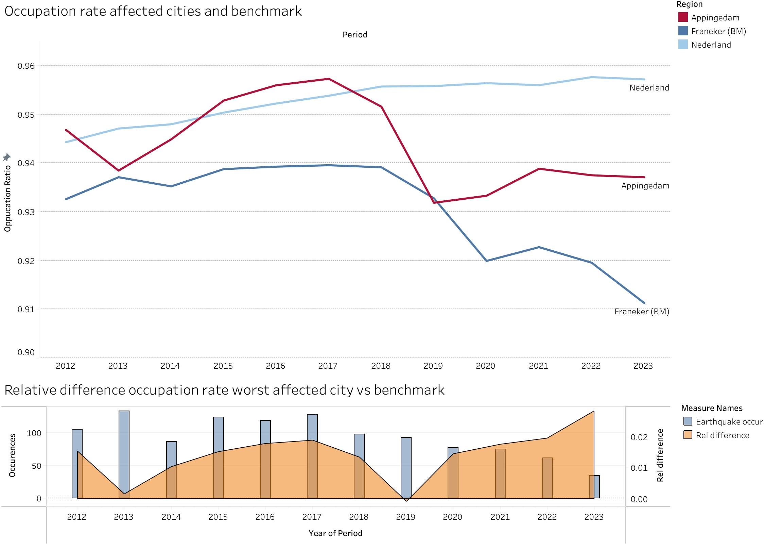
Findings: Occupation rate for affected cities and benchmark
CITIES
One-tailed paired t-test
Null hypothesis: occupation rate of target city and benchmark are equal =
Alternative hypothesis: occupation rate of target city is lower than benchmark <
Alpha = 0.0500
t-statistic: 6.3175
p-value: 0.9999
P-value > alpha, failed to reject null hypothesis:
-> Answer: There is not enough evidence to conclude that the occupation ratio in target city is significantly lower than in benchmark city.
Target city had a lower occupation ratio in 1 out of 12 periods.

Slide 23
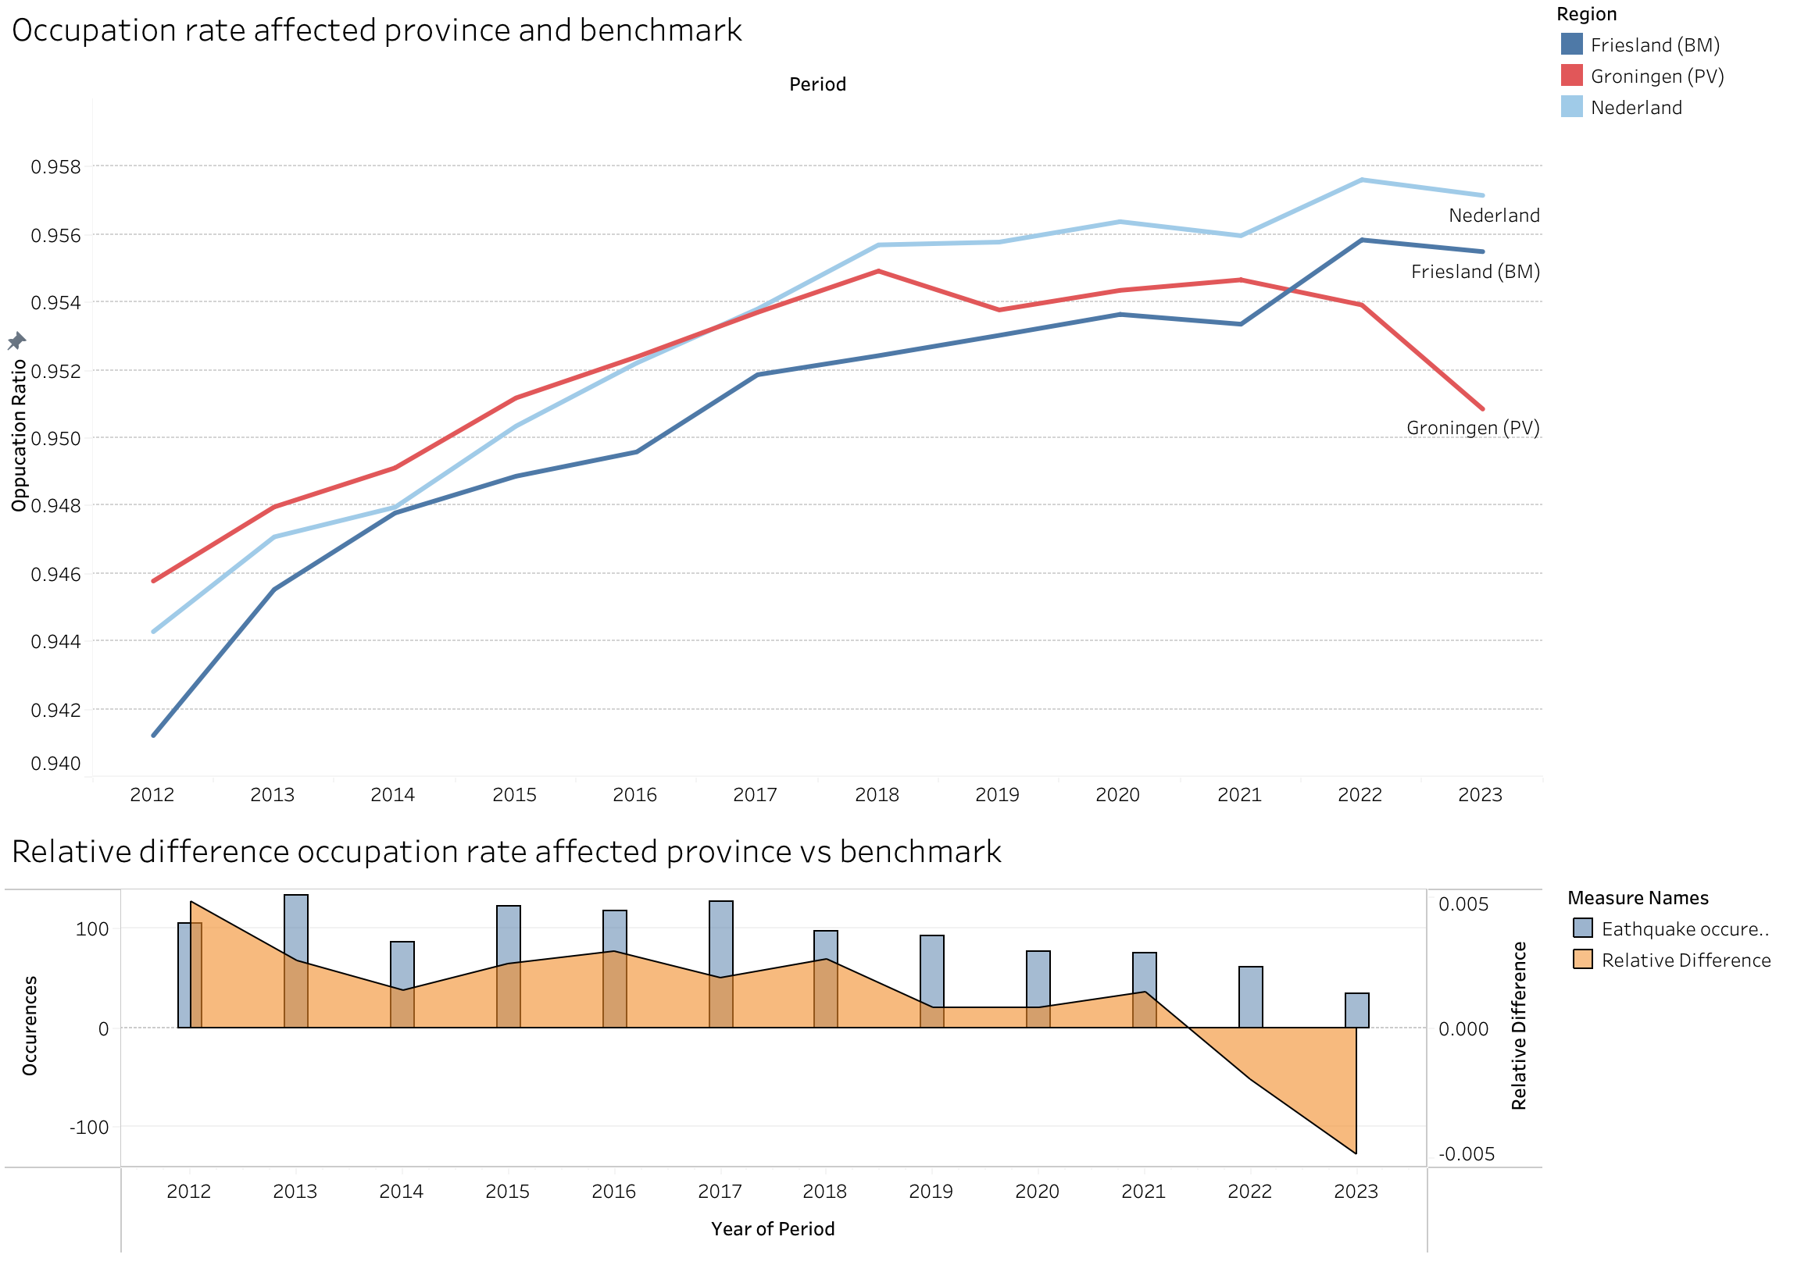
Findings: Occupation rate for affected region and benchmark
REGION
One-tailed paired t-test
Null hypothesis: occupation rate of target region and benchmark are equal =
Alternative hypothesis: occupation rate of target region is lower than benchmark <
Alpha = 0.0500
t-statistic: 1.6863
p-value: 0.9401
P-value > alpha, failed to reject null hypothesis:
-> Answer: No evidence that target region has a lower occupation ratio than benchmark region.
Target region had a lower occupation ratio in 2 out of 12 periods.

Slide 24
Conclusion
Hypothesis_1: Gas extraction has negatively impacted local real estate value
➡️ Prices seem to be significantly lower in both the target city and target region compared to their respective benchmarks
Hypothesis_2: Areas impacted by gas extraction are less occupied than areas that are not impacted
➡️ There is no evidence that both the target city and target region has a lower occupation ratio compared to their respective benchmarks.

Slide 25
Challenges
Availability
Complete historical real estate data was only available for just a few impacted cities/villages;
Timeframe inconsistency
From the real estate data that was obtained, a lot of timeframe periods made them unsuitable. For example, a city that only has data from 1997 up to 2010.
Inventory and occupation figures were only available from 2012 to 2024.

Slide 26
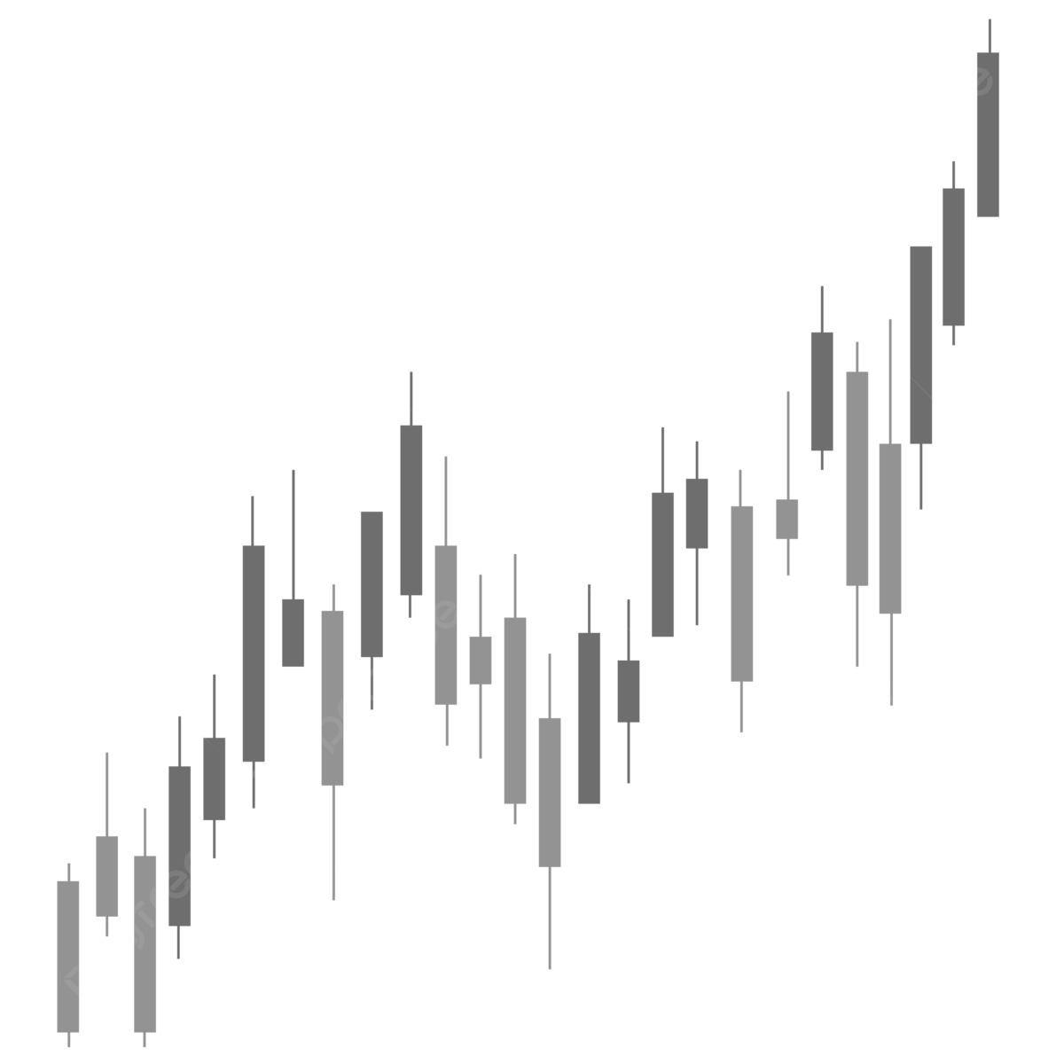

Limitations
Testing results rely heavily on discretionary benchmark picking. Benchmarks may not always create reliable pictures since they are unique compared to the target area.
Real estate prices and occupation rates are strongly dependent on (non-exhaustive):
General demand
Interest rates (cost of lending)
Economical attractiveness of area
Geographical location / infrastructure
Demographics
Availability
Secondary benefits of living area
(subjective) Personal preference

Slide 27
Recommendations
Additional in-dept research needs to be done to include more independent variables. However, due to the uniqueness of each region, finding appropriate benchmarks will remain to be difficult due to the variety of independent factors influencing price and availability.
➡️ A suggestion is that a combination of qualitative and quantitative studies needs to be done in order to get a full picture on the effects of gas extraction and its effects on real estate values.

Slide 28

Thank you

